Slide 1
draft-lechler-mlcodec-test-battery-00
IETF 123, 24 July 2025
A Comprehensive Listening Test Battery for ML Audio Codec Evaluation
Presenter: Laura Lechler (Cisco Systems)

Slide 2
Motivation of draft-lechler-mlcodec-test-battery-00
- no specific evaluation procedure described for DRED
- evaluation of generative models faces new challenges compared to traditional codecs (both objective metric and human listening tests impacted)
- recent concerns [1] and recommendations [2] regarding listening tests addressed as follows:
Concern | Ref | Proposed Improvement
ACR reference-free (range-equalizing biases!) | [1] | A. MUSHRA 1S (single test stimulus) for clean input data B. DCR for (mild to moderate) real-world noise and reverberation
Both clean and noisy speech should be tested | [2] | Testing real-world speech in noisy and reverberant conditions
Intelligibility not typically assessed (e.g., in P.808) | [1] | A. add intelligibility test (DRT), B. qualification filters to recruit native speakers (large platform-specific differences)
[1] Marvin Sach, Yihui Fu, Kohei Saijo, Wangyou Zhang, Samuele Cornell, Robin Scheibler, Chenda Li, Anurag Kumar, Wei Wang, Yanmin Qian, Shinji Watanabe, Tim Fingscheidt. ”P.808 Multilingual Speech Enhancement Testing: Approach and Results of URGENT 2025 Challenge”. arXiv preprint, Jul 2025. [2] Thomas Muller, Stéphane Ragot, Laetitia Gros, Pierrick Philippe, Pascal Scalart. “Speech quality evaluation of neural audio codecs.” INTERSPEECH, Sep 2024, Kos Island, Greece.

Slide 3
Listening Test Battery
Test​ Data | Test Type | Assessment of
Clean | MUSHRA-1S​¹ | Quality with high-quality inputs
Real-world | DMOS​ | Quality in real-world reverberation & noise
Clean​ | DRT | Phoneme-level intelligibility
Data to be open-sourced as part of the forthcoming Low-Resource Audio Codec Challenge.
¹MUSHRA 1S: MUSHRA test with a single test stimulus, anchor, and reference

Slide 4
Conditions tested to illustrate test capabilities
All inputs:
single-channel, 16kHz, 16bit (i.e., for Opus silk is enabled, CELT is not used)
level normalized for speech to be at approximately –23 to –26 RMS dB
Codecs under test:
Opus WB basic complexity at 6 kbps (as anchor/lower point of reference)
Opus WB basic complexity at 9 kbps
Opus WB LACE at 9 kbps
Opus WB NoLACE at 9 kbps
DRED Standalone¹ at 0.5 kbps
DRED Standalone at 1 kbps
DRED Standalone at 2 kbps
Input files (clean speech or real-world reverberant speech in noise) used as reference
Output files were not level-adjusted.
Participants for listening tests were recruited on Prolific (details in draft).
¹The Python implementation of DRED Standalone was kindly contributed by Ahmed Mustafa.

Slide 5
Speech Quality Assessment

Slide 6
MUSHRA 1S: Evaluating one stimulus at a time
Traditional MOS/MUSHRA
MUSHRA-1S
advantage
MOS scales well
MUSHRA consistent and sensitive
MOS suffers from range-equalizing biases [3]
MUSHRA limited to low number of systems
scales well
clear range of expectation
simplified task
more sensitive than MOS
less sensitive than MUSHRA
MOS
MUSHRA
disadvantage
[3] Cooper, E. and J. Yamagishi "Investigating Range-Equalizing Bias in Mean Opinion Score Ratings of Synthesized Speech." INTERSPEECH 2023, p.1104--1108

Slide 7
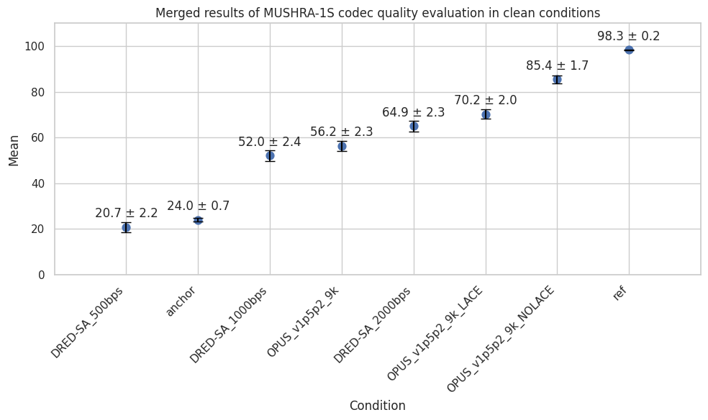
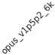
Quality Evaluation – Clean

Slide 8
DCR: Evaluating degradation in real-world conditions
Degradation Category Ratings (from which DMOS can be calculated)
Evaluates degradation compared to a reference (as opposed to ACR, which is reference-free)
Can be used also when no clean reference is available (e.g., noisy/reverberant real-world data)
We used a controlled distributed test design, exposing each listener to one stimulus of each codec
DMOS scale according to ITU P.808 [4]:
5 – Degradation is inaudible.
4 – Degradation is audible but not annoying.
3 – Degradation is slightly annoying.
2 – Degradation is annoying.
1 – Degradation is very annoying.
[4] ITU-T. "Subjective evaluation of speech quality with a crowdsourcing approach.” ITU-T Recommendation P.808, 2021

Slide 9
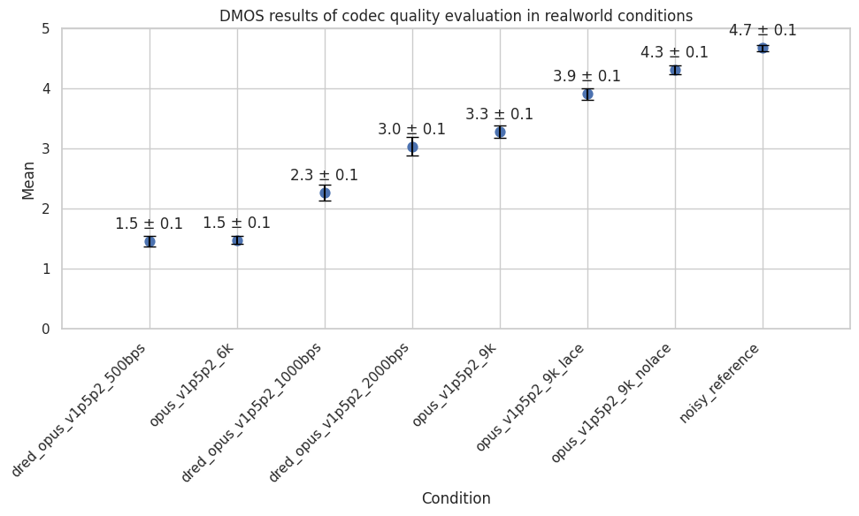
Quality Evaluation - Mild reverberation and noise (real-world)

Slide 10

Listening Examples DCR
filename | real-world focus | DRED-SA 0.5kbps | DRED-SA 1kbps | DRED-SA 2kbps | Opus 1.5.2 9kbps
realworld_data_031.wav 4.75 | noisy child speech (fan/AC) | 1.71 | 1.71 | 1.00 | 3.8
realworld_data_045.wav 4.25 | noisy male speech (traffic noise) | 1.22 | 1.94 | 1.20 | 3.15
realworld_data_063.wav 4.29 | reverberant male speech | 1.14 | 1.40 | 2.17 | 3.50
realworld_data_054.wav 4.80 | reverberant female speech | 1.25 | 2.65 | 4.29 | 2.25

Slide 11
Speech Intelligibility Assessment

Slide 12
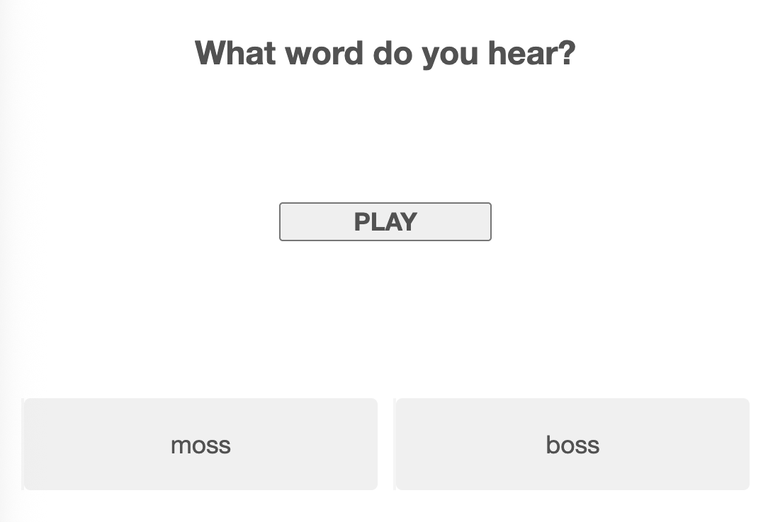
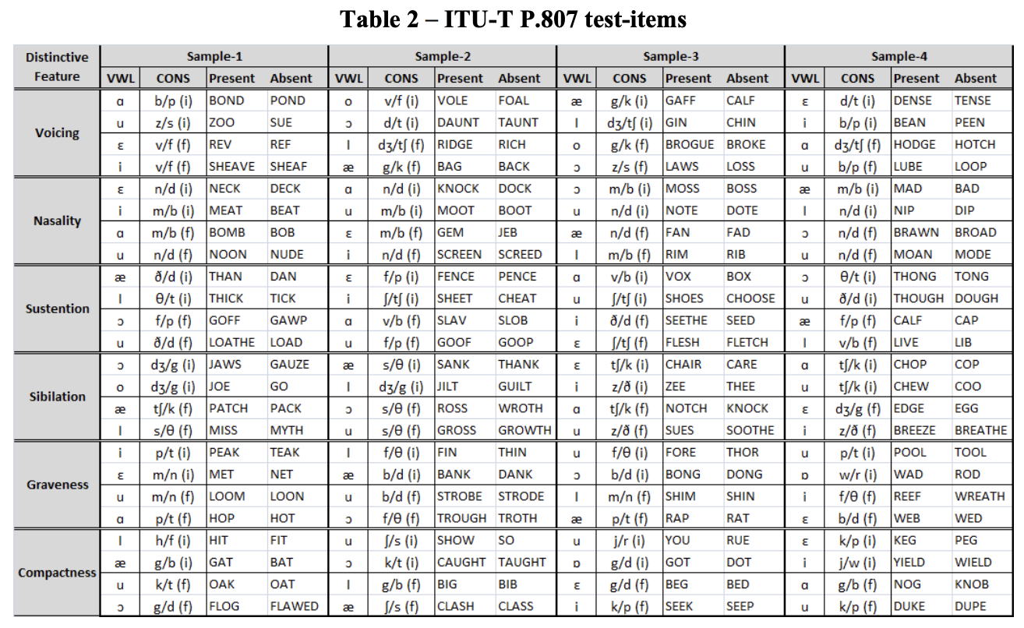
Diagnostic Rhyme Test (DRT)
ITU-recommended method [5]
phoneme-level intelligibility assessed
no context effects
no learning effect
successful test adaptation for crowdsourcing [6]
test vectors in several languages and software to set up test open-sourced [7]
[5] ITU-T "Subjective test methodology for assessing speech intelligibility" ITU-T Recommendation P.807, 2016. [6] Lechler, L. K. Wojcicki "Crowdsourced Multilingual Speech Intelligibility Testing." ICASSP 2024. [7] Cisco Systems "Multilingual Speech Testing - Speech Intelligibility DRT" https://github.com/cisco/multilingual-speech-testing/tree/main/speech-intelligibility-DRT

Slide 13
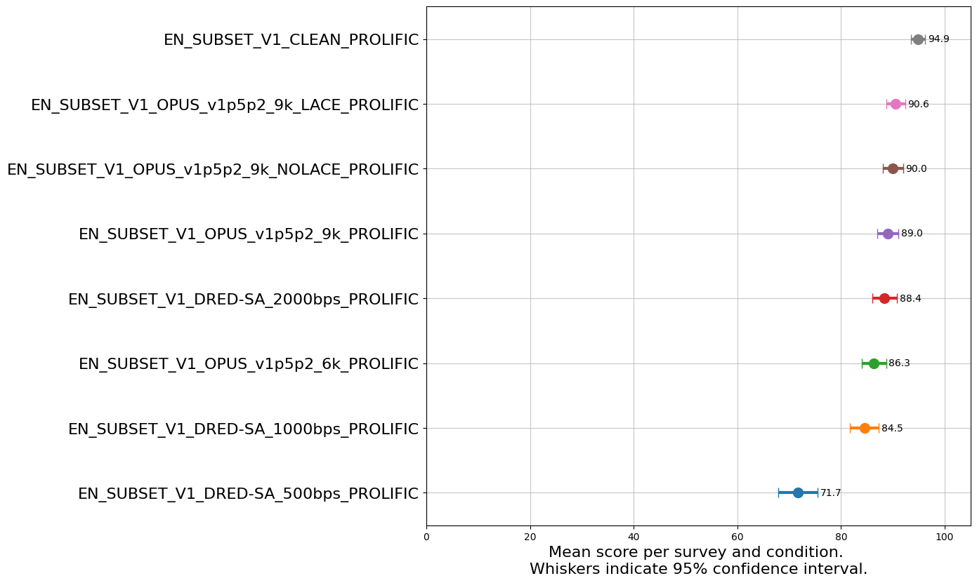
Intelligibility Evaluation – Clean
Overall results of the Diagnostic Rhyme Test for English

Slide 14
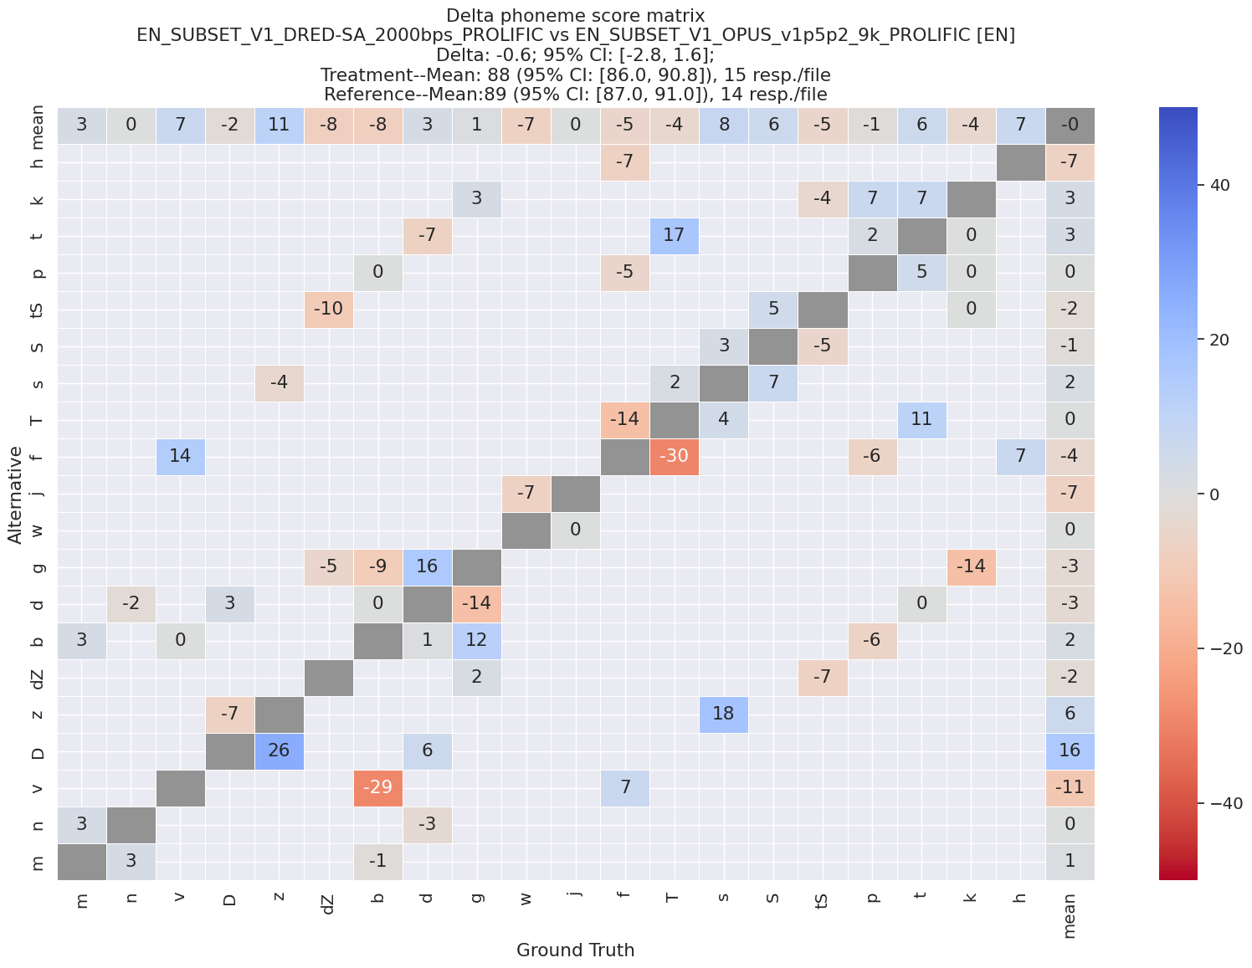
Delta Phoneme Scores
Some improvements over Opus!
Some degradations

Slide 15
Listening Examples DRT
filename/ target word/ alternative | clean | Opus 1.5.2 9kbps | DRED-SA 2kbps | DRED-SA 1kbps | DRED-SA 0.5kbps
sues_A18Q27VK32D8M7_e76bf705fabc4ec38c78d4452491b5ec.wav sues soothe | 75 | 0 | 73 | 73 | 73
lib_AVLSFS5SYL5WG_f602fd78431a43f6be02a222b7f1e539.wav lib live | 100 | 100 | -60 | -29 | -14
net_A1NQOR4RQJJDMW_bc5564893576480e9735215e4f27fb41.wav net met | 100 | 100 | 47 | -60 | 60
got_A3942QGFYCSDRM_eea5384f918540939b71d5d5cbb5baca.wav got dot | 86 | 87 | 33 | -14 | -100

Slide 16
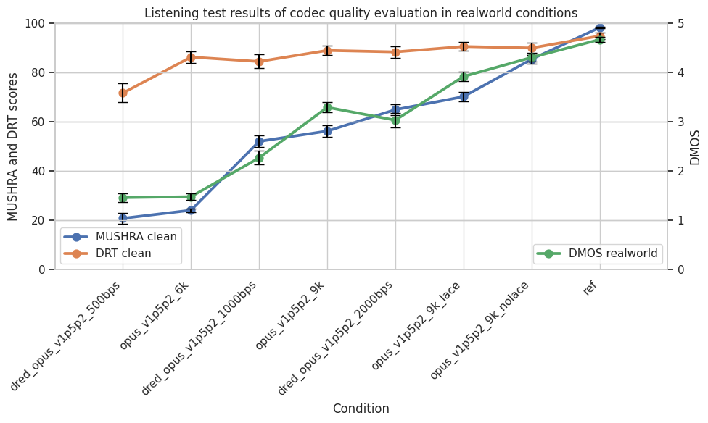
Summary Results
A
B
C
DRED 0.5 kbps & Opus 6kbps: - comparable quality - Opus 6kbps better intelligibility
DRED 1kbps, Opus 9kbps, DRED 2kbps: - DRED 2kbps best quality in clean - Opus 9kbps highest resilience to real-world noise and reverberation - Opus 9kbps slightly better intelligibility
Opus 9kbps LACE & NoLACE: - NoLACE superior quality in clean and real-world conditions - both LACE and NoLACE improve over Opus 9kbps in quality tests - comparable intelligibility

Slide 17
Next steps?
Test​ Data | Test Type | Assessment of
Clean | MUSHRA-1S​¹ | Quality with high-quality inputs
Real-world | DMOS​ | Quality in real-world reverberation & noise
Clean​ | DRT | Phoneme-level intelligibility
Noisy | DRT | Phoneme-level intelligibility in SSN
Multi-talker conversation | DMOS | Preservation of simultaneous talkers
Lossy | TBD | PLC and blending

Slide 18
Appendix

Slide 19
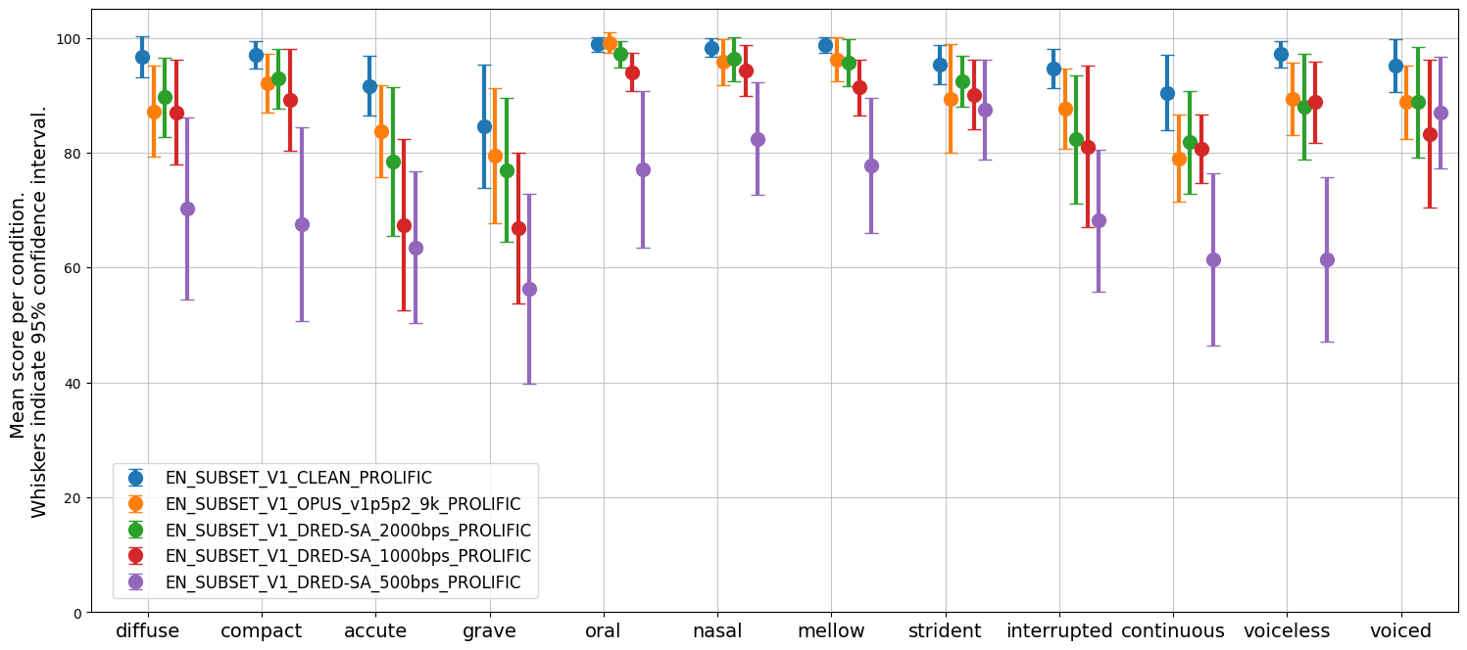
Results by Phonetic Feature State
Example for DRED 0.5 kbps: In voicing category:
voiced consonants (e.g., /b/) generally correct
voiceless consonants (e.g. /p/) often confused
Speech Intelligibility Scores
|
|
|
|
|
compactness | graveness | nasality | sibilation | sustention | voicing

Slide 20
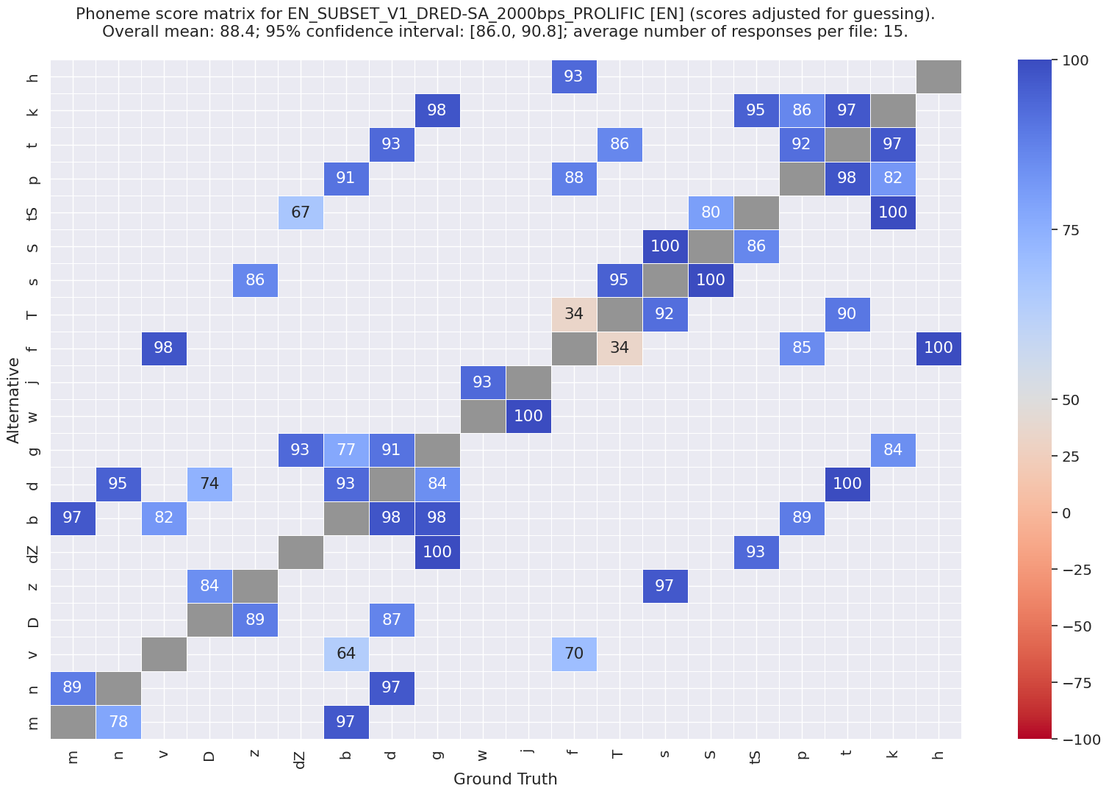
Results by Phoneme Pair
DRT scores (%_{correct} adjusted for guessing)
full intelligibility
preference for target
considerable degradation
chance/blind guessing
preference for alternative
full phoneme confusion

Slide 21
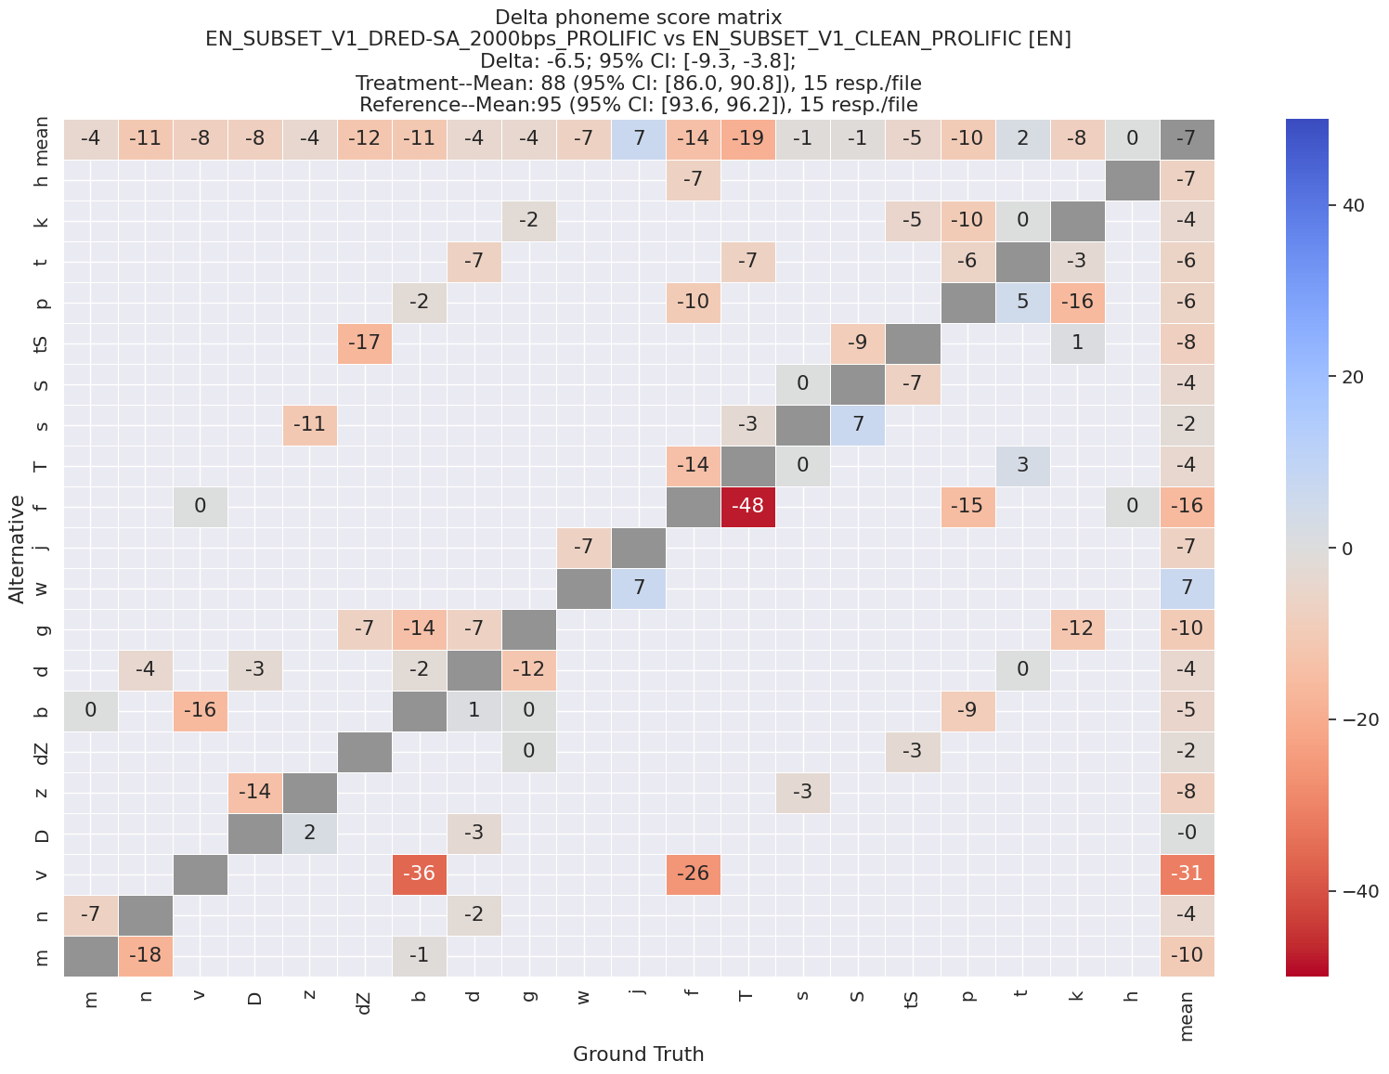
Delta Phoneme Scores
DRT delta scores (DRT_score_{DRED2} – DRT_score_{CleanBaseline})
improvement over baseline
equal intelligibility
degradation over baseline

